Slide 1
The Reformation
World History II

Slide 2
Conflicts that challenged the Authority of the Roman Catholic Church
Merchant wealth challenged the Church’s view of usury
German and English nobility disliked the Italian domination of the Church
The Church’s great political power and wealth caused conflict
Church corruption and the sale of indulgences were widespread and caused conflict

Slide 3
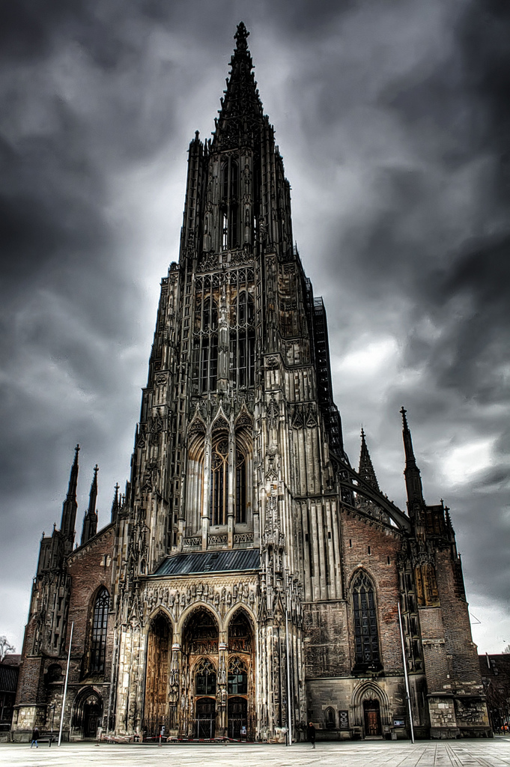
Impact of Reformation in Germany
Princes in Northern Germany converted to Protestantism, ending the authority of the Pope in their states.
The Hapsburg family and the authority of the Holy Roman Empire continued to support the RCC.
Conflict between Protestants and Catholics resulted in devastating wars: Hapsburg-Valois Wars 1521-1555 and the Thirty Years’ War 1618-1648.

Slide 4
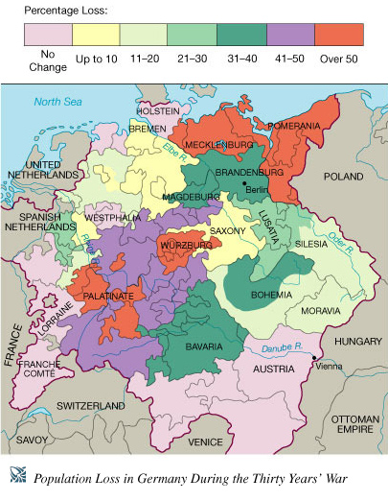
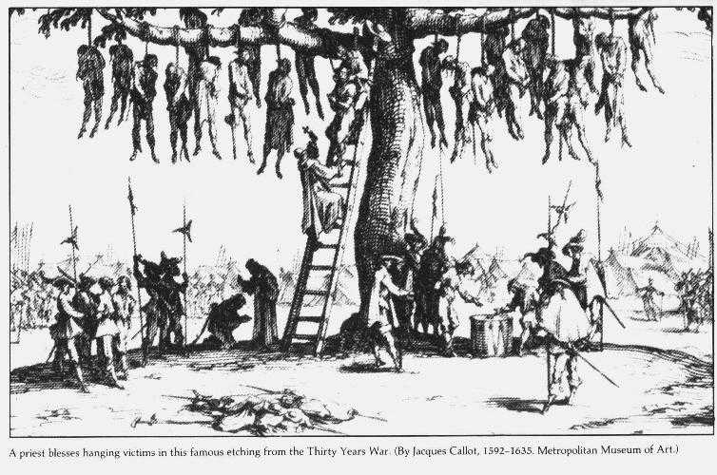

Slide 5
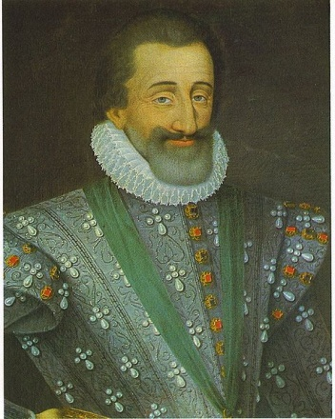
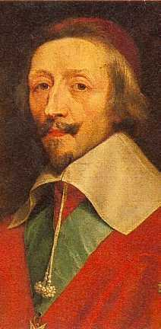
Impact of Reformation in France
Catholic monarch, Henry IV, granted Protestant Huguenots freedom of worship by the Edict of Nantes
Cardinal Richelieu changes the focus of
the Thirty Years’ War from a religious to a political conflict by siding with the Protestants against the Catholics

Slide 6
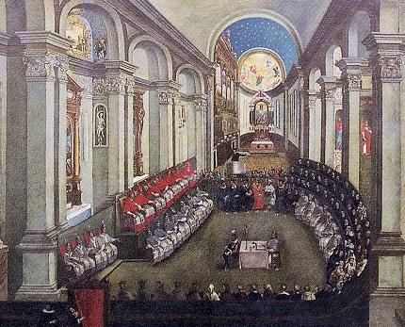
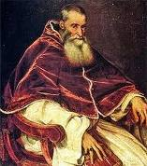
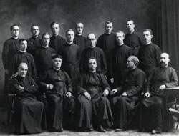
Catholic Reformation (The RCC Strikes Back)
The Council of Trent reaffirmed most Church doctrine and practices.
The Society of Jesus (Jesuit order) was founded to spread Catholic doctrine around the world.
Pope Paul III

Slide 7
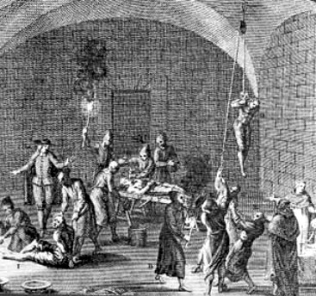
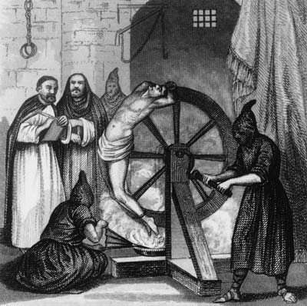
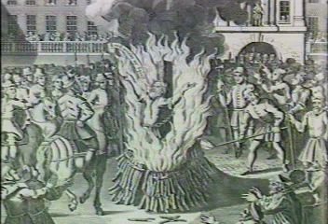
The Inquisition was used to reinforce Catholic doctrine.

Slide 8
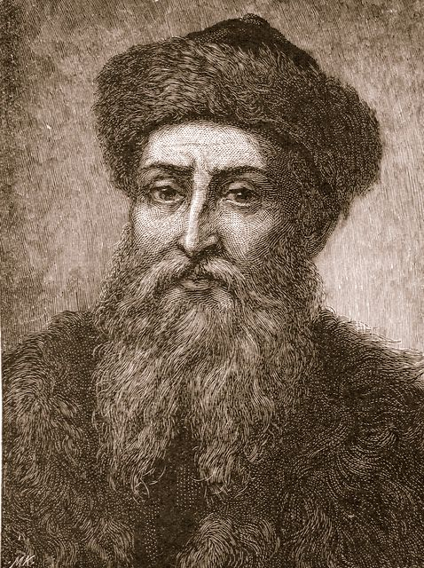
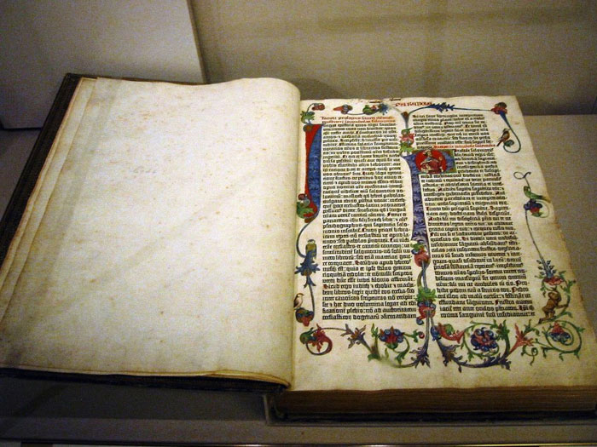
Role of the Printing Press
Growth of literacy was stimulated by the Gutenberg printing press.
The Bible was printed in English, French, and German
These factors had an important impact on spreading the ideas of the Reformation and the Renaissance
Secularism
Individualism
Humanism

Slide 9
The Big Idea
What were some of the changing cultural values, traditions, and philosophies during the Reformation?
Growth of secularism
Growth of individualism
Eventual growth of religious tolerance

