Slide 1
Simulations with Swagger
Simulations for the world history classroom

Slide 2
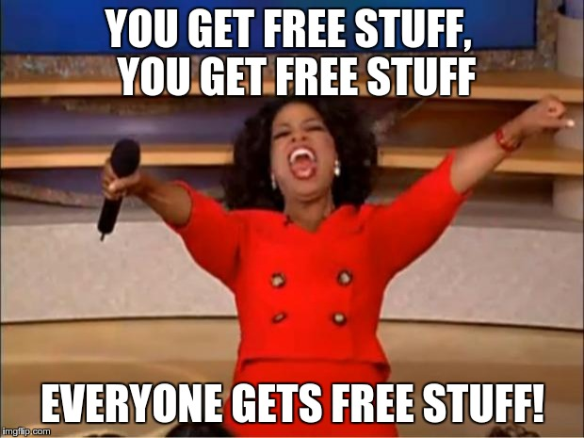
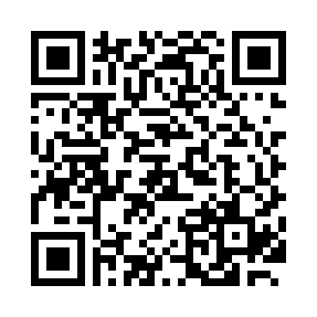
Free Resources!
We’ve put together a bunch of free simulations we have used in our classrooms. Feel free to steal and adapt as you wish!
www.larouetallwood.weebly.com

Slide 3
What is a simulation?
Students re-enact or become the “players” of an historical event.
Students physically, emotionally, & mentally engage with the content.
Example:
  French Revolution- Students re-enact the French Revolution in 90 minutes.
  Scramble for Africa – Students experience colonization in Africa by “claiming” different strategic items in the classroom.
  Workers rally- Students give speeches at a worker’s rally following the Industrial Revolution to show understanding of new political ideas such as socialism.
  Development of Greek city-states – Students form city-states and “trade” goods with each other. (World History 1)

Slide 4

Roadblocks to simulation
Time
It can get really noisy, messy, hectic, and chaotic at times
Classroom set up
Manipulative/supplies
Topic choices! Example: Genocide
Be Brave! It is well worth the work!

Slide 5
Why do simulations?
Students are 90% more likely to remember what they do, hear, and see
Everyone participates -- think about your wallflowers and students who never sit still
FUN! FUN! FUN!

Slide 6

Let’s try it!
Come on…don’t be scared
We won’t grade you ☺

Slide 7
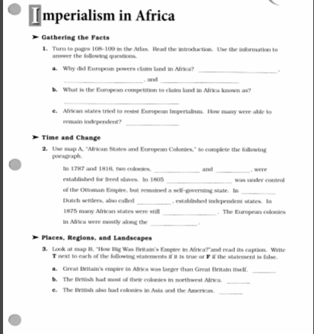
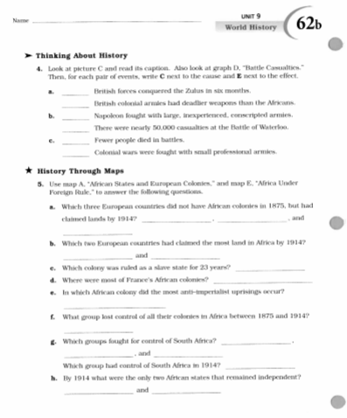
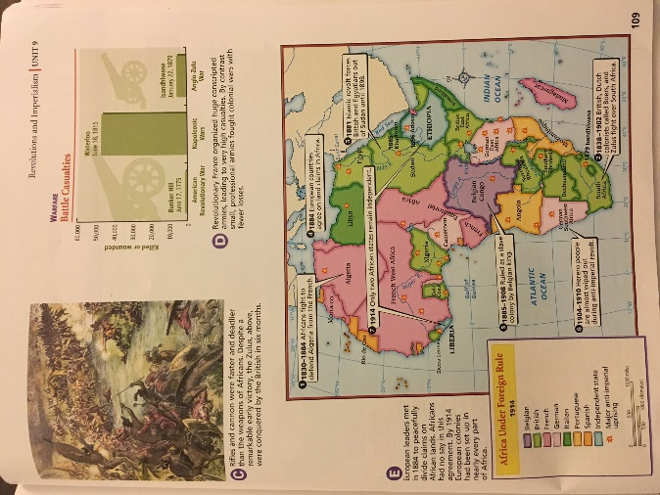
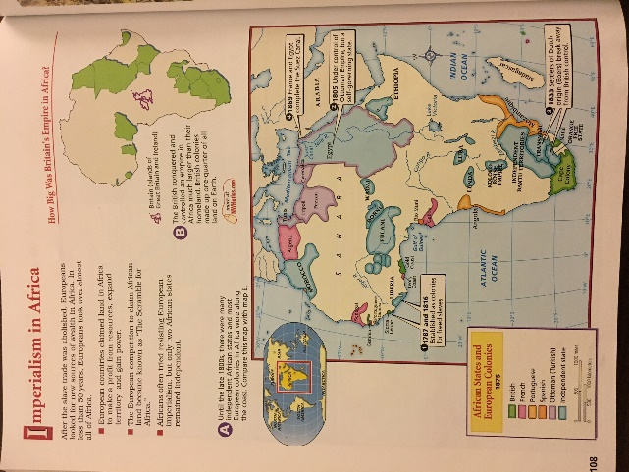
Background information
Historical Atlas Activity – This can be done either before you do the Scramble or after. It depends on how much of a surprise factor you are going for.

Slide 8
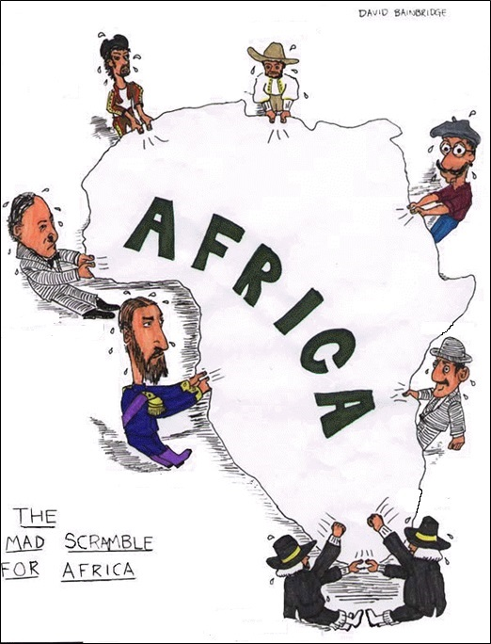

Scramble for Africa
Opener:
What is going on?
What countries are represented?

Slide 9
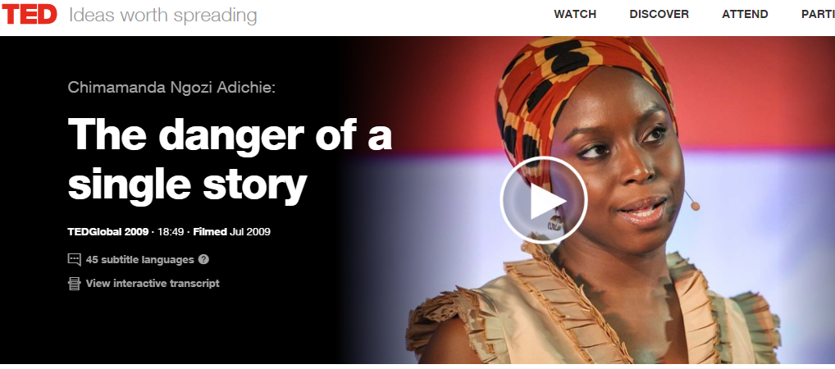
Multiple Perspectives
Video we show next:
The Danger of The Single Story - https://www.ted.com/talks/chimamanda_adichie_the_danger_of_a_single_story
Students are told to simply watch and think about how this might relate to what we are doing next.
Teacher note: a nod to what is coming next – resistance!

Slide 10
You are a new teacher and have been given a room full of items left over from the last teacher. However, there are rival teachers who also want this room and its contents.
In order to keep the stuff you need to be the greatest teacher ever you have to “claim it.”
The good news is you have friends that will help you ☺
You “claim” items by putting your group’s post-it-note (with symbol) on the item.
Think carefully about which items you want to keep and WHY.
You must follow ALL instructions on the laminated card or BE SENT TO A PORTABLE!

Slide 11
CLAIM IT!
Think about WHAT you are claiming and WHY.
You will have to turn in a written list of WHAT and WHY

Slide 12
Let’s think about this…
Each group shares with the whole class the two most important items they claimed and why.

Slide 13
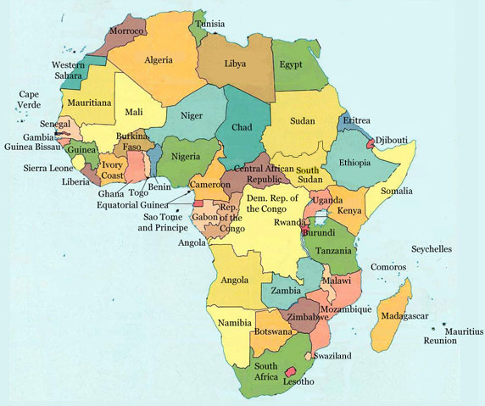
SPOILER ALERT!!! This was really about imperialism in Africa ☺
What country do you think you were? WHY?
What are the drawbacks to dividing Africa this way? What are the positives?
Predict what will happen based on what happened during the activity.

Slide 14
Draw 3 lines to divide the territory into 3 nations

Slide 15
Draw 3 lines
to divide the territory into 3 nations

Slide 16
Let’s think about it…
Why did Europeans choose this method to dividing Africa rather than another?
Why were the language groups not taken into account?
What problems does this create in Africa?
What are the ethical implications of the Scramble for Africa?

Slide 17

Questions?
Thank you for coming to our session!
Check the website for digital copies of everything and more!
Don’t forget to be awesome.

