Slide 1
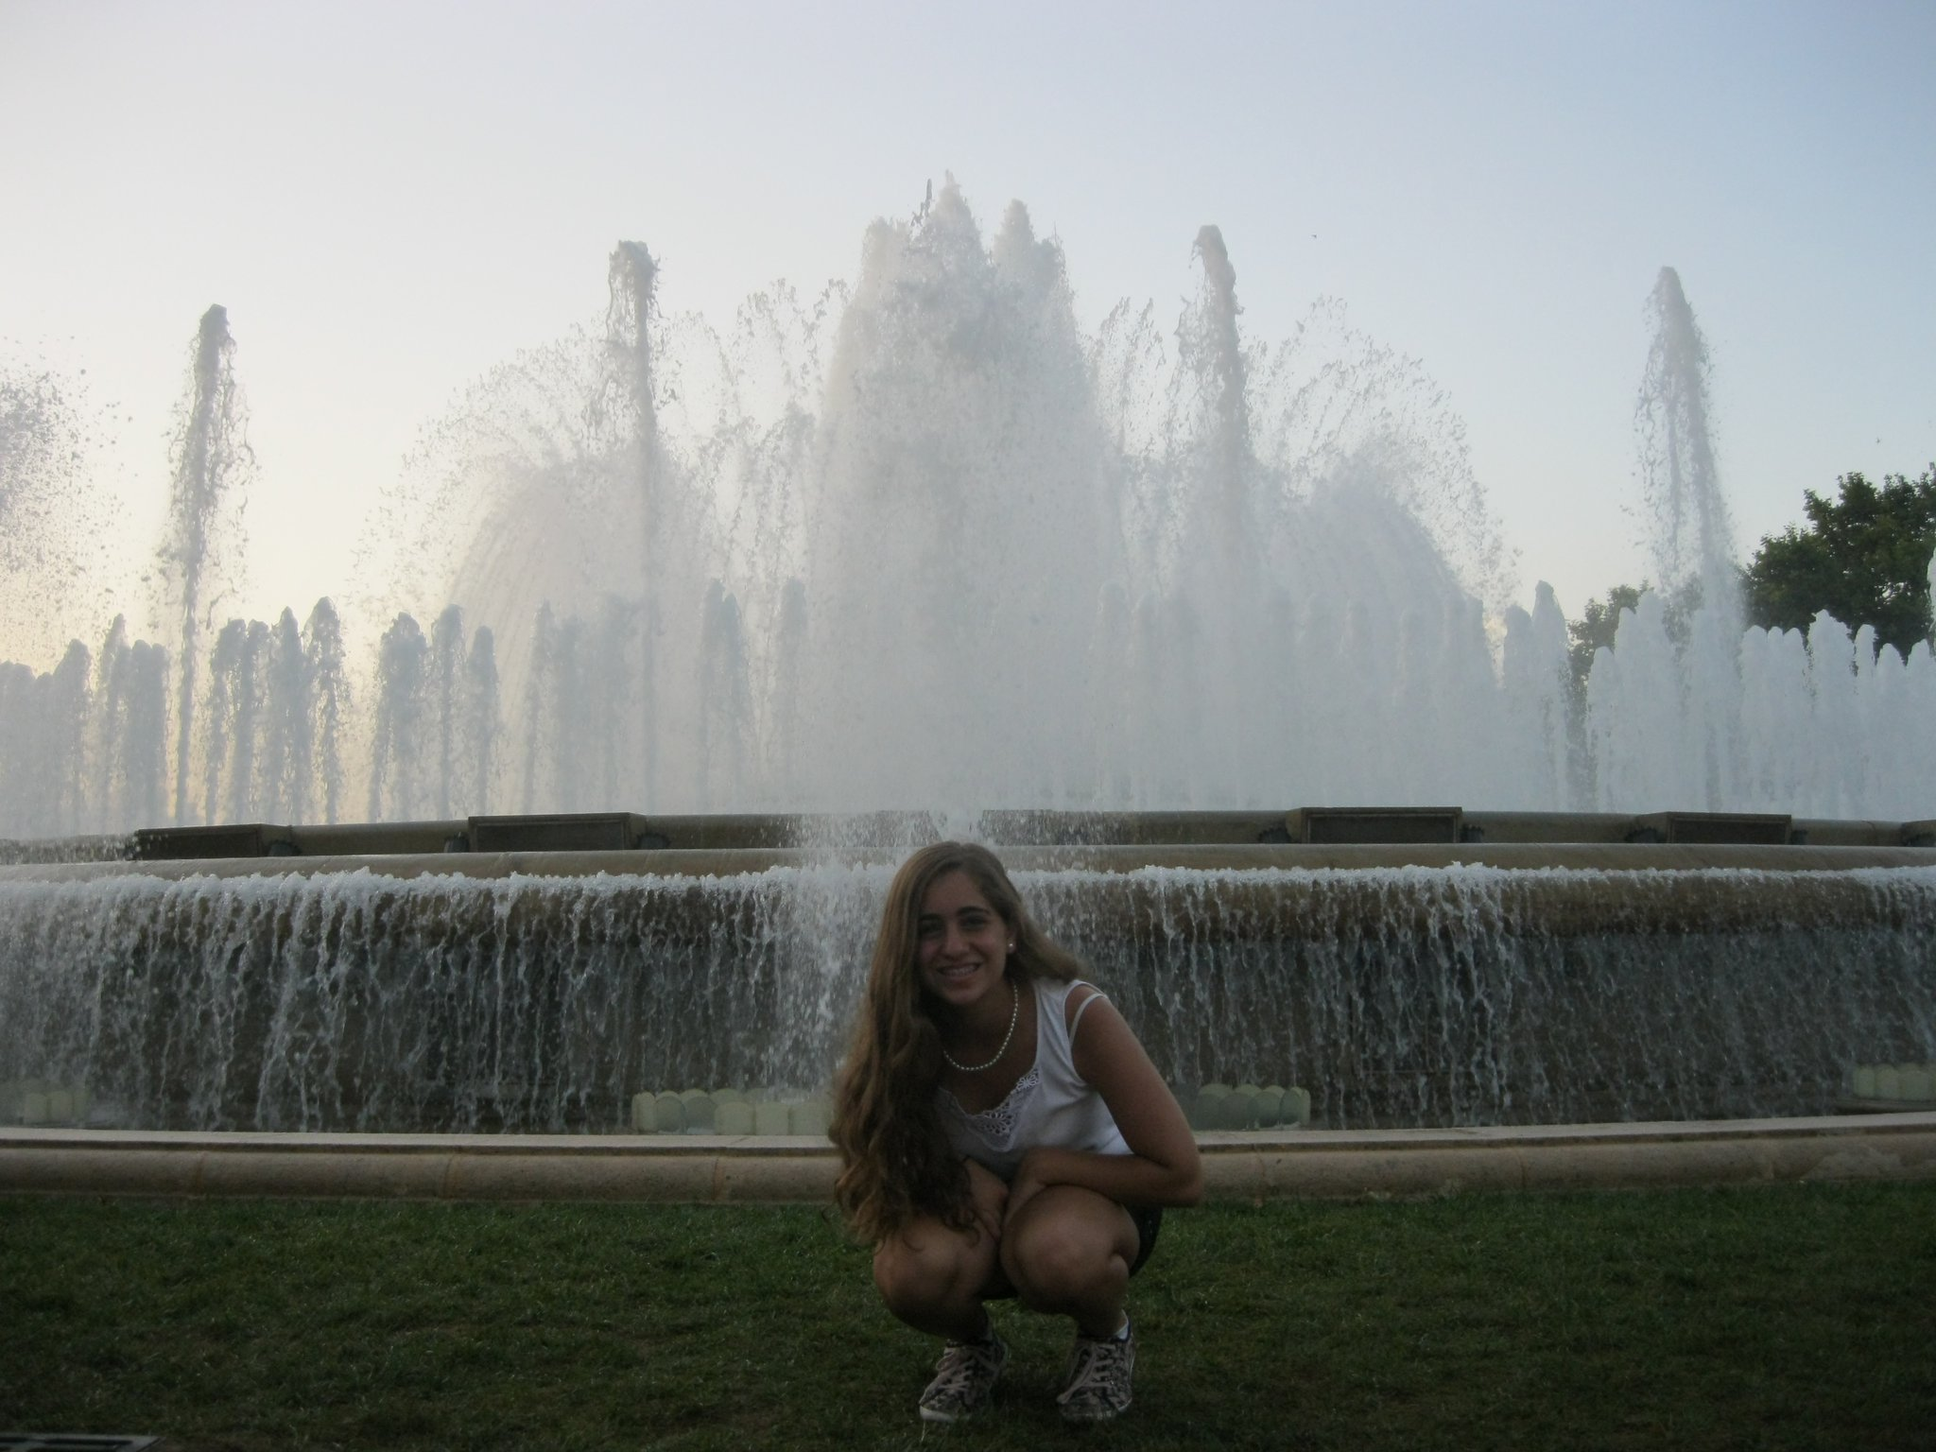
Shir yizchaki
שיר יצחקי

Slide 2
The meaning of
my name “SHIR”
is the word“SONG”
in English

Slide 3
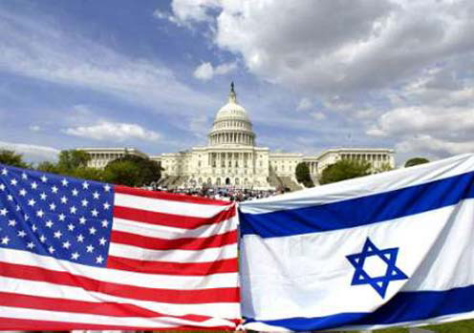
Young ambassadors

Slide 4
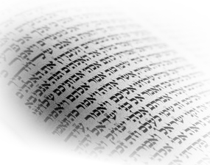
The Hebrew language
Hebrew is the formal language of Israel. It’s the Bible language and it’s written from right to left.

Slide 5
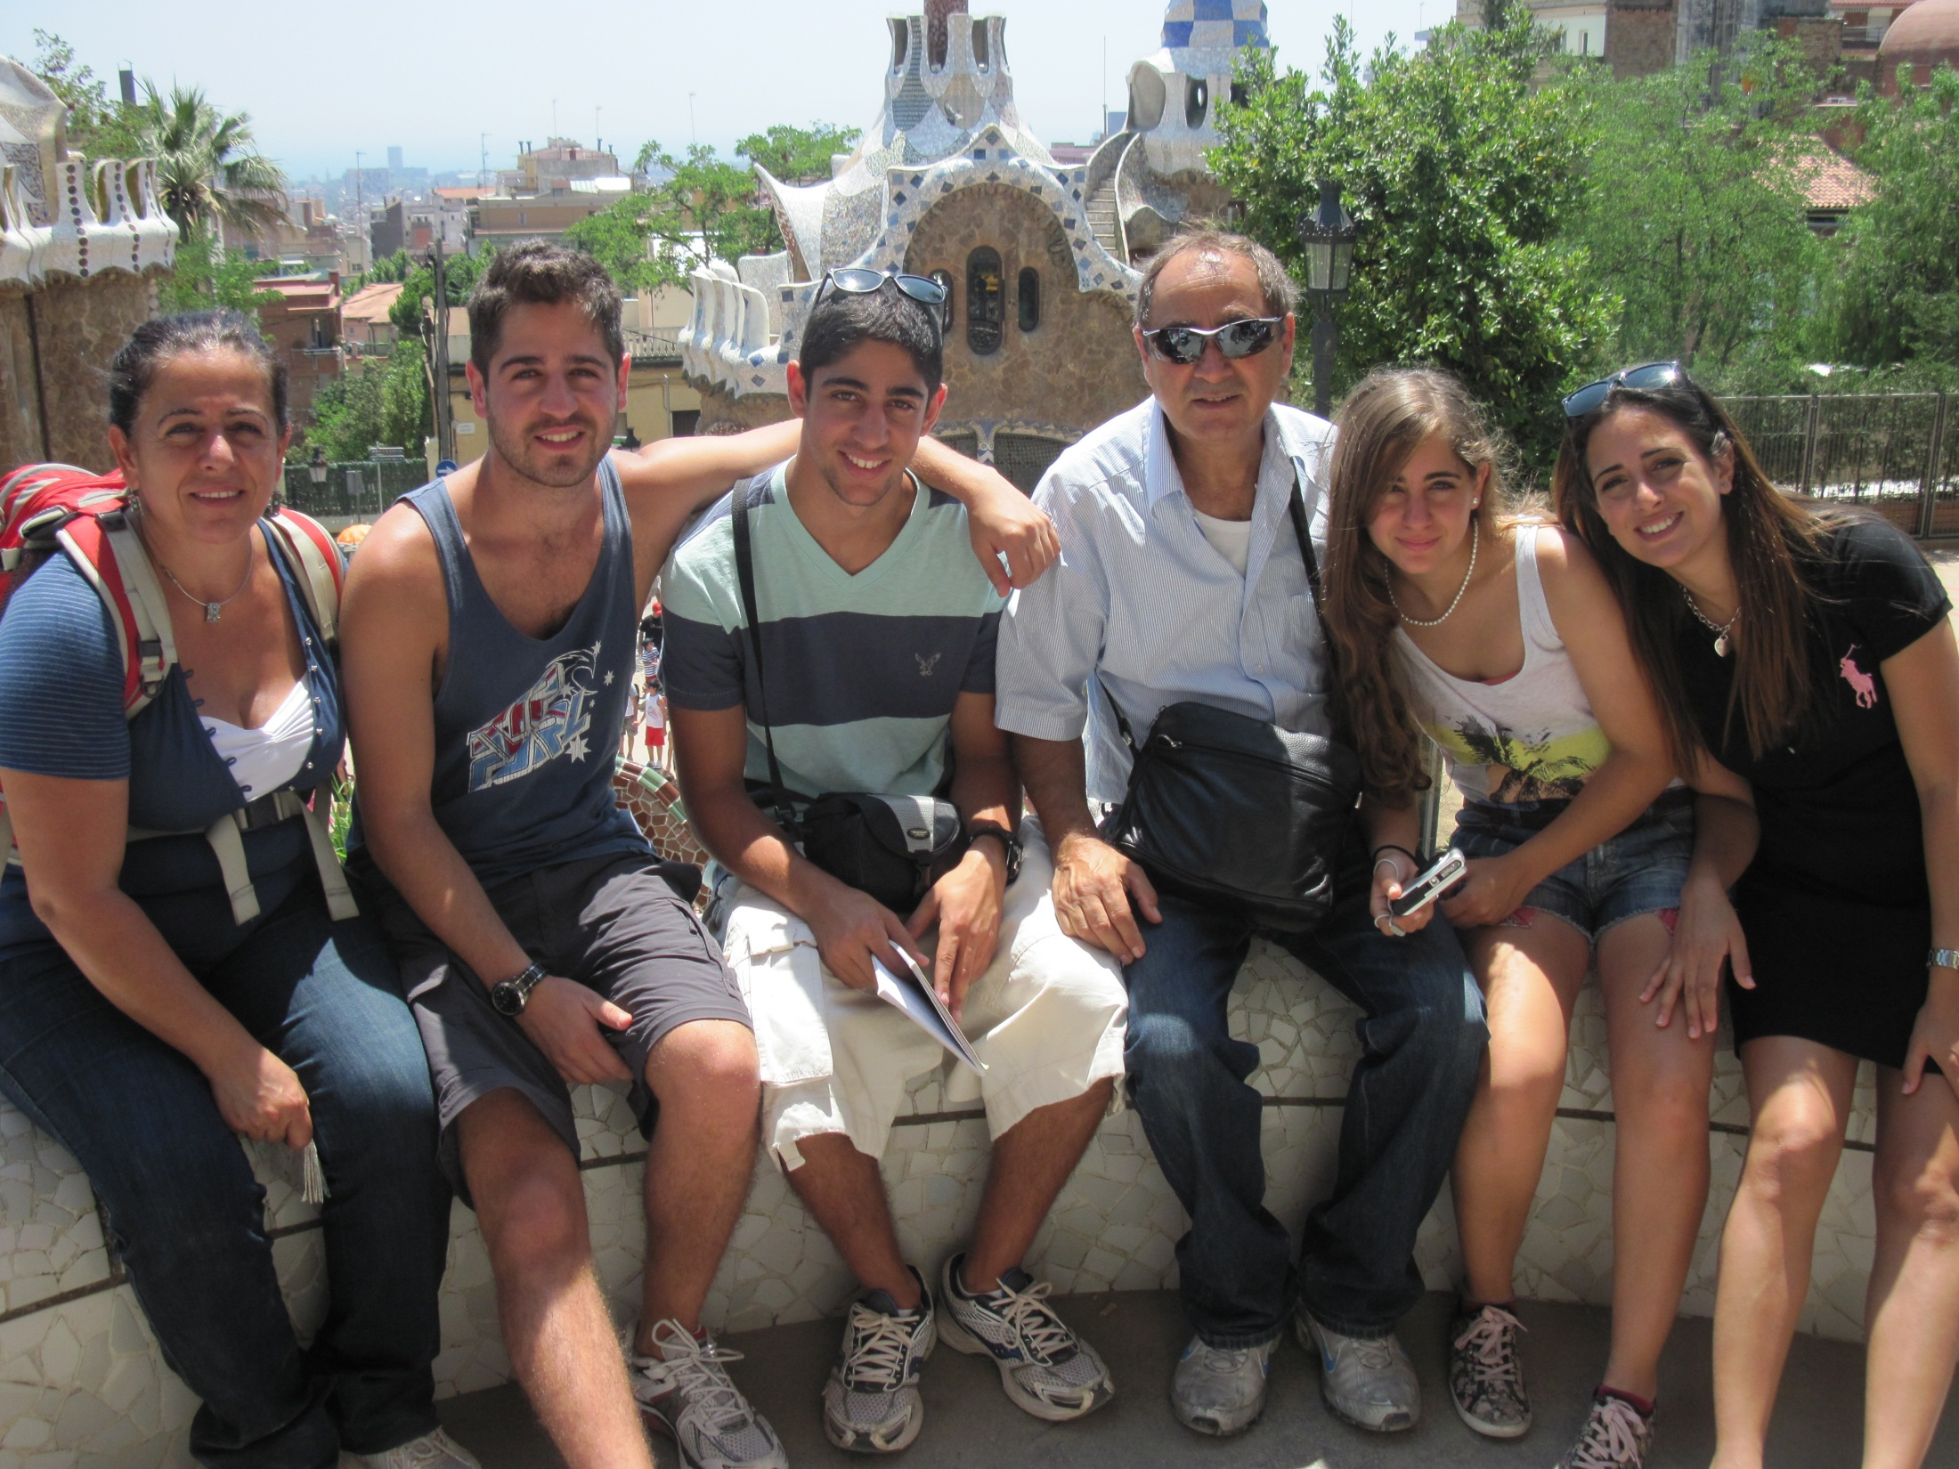
My Family
My Mother –works as a Director of Human Resources
My older Brother –
In the IDF in the navy forces
My Father-
Works as a logistic manger
Me!
My Big Sister-
A student in College
My Big Brother-
A student in the University.

Slide 6
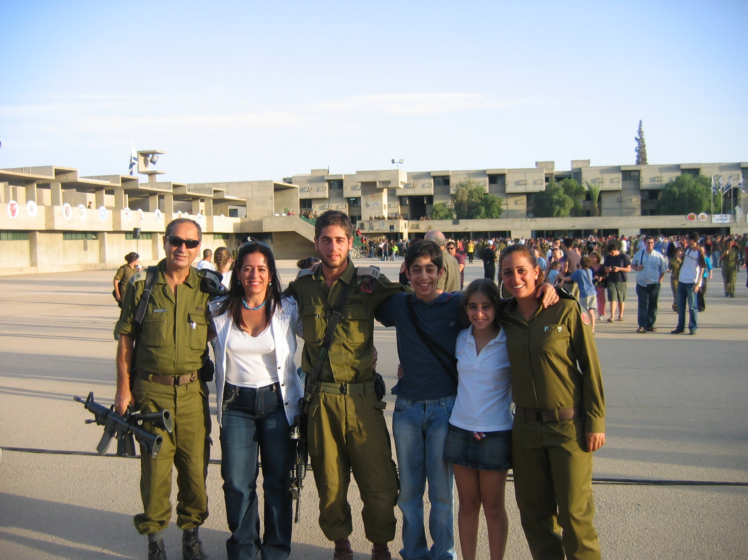

Slide 7
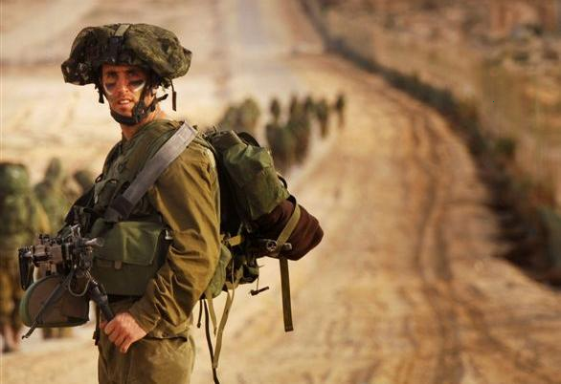
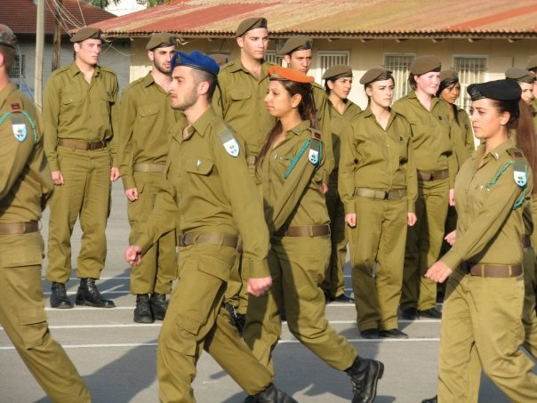
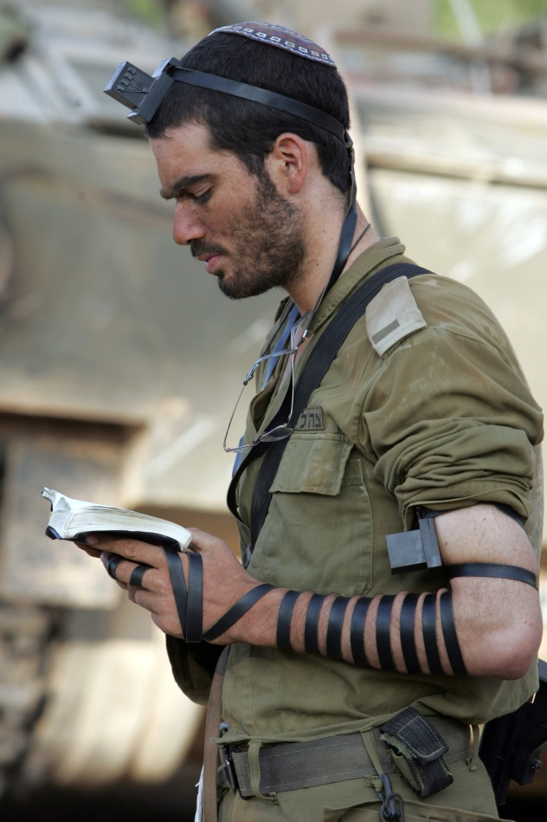
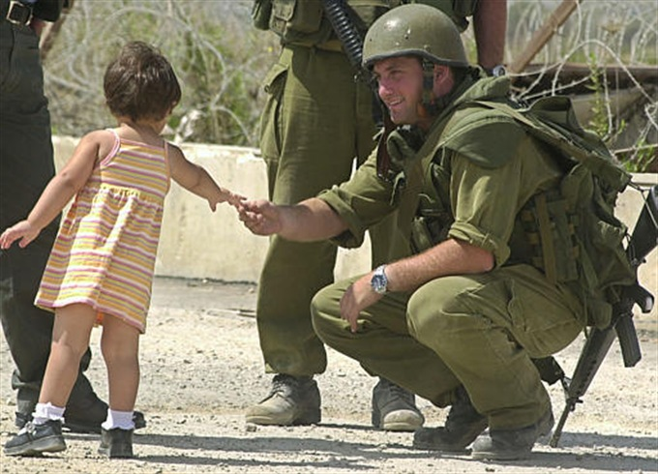
IDF
Israel Defense Forces

Slide 8
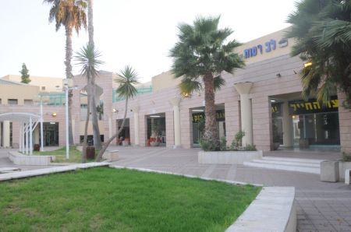
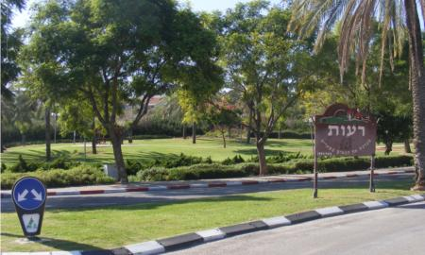
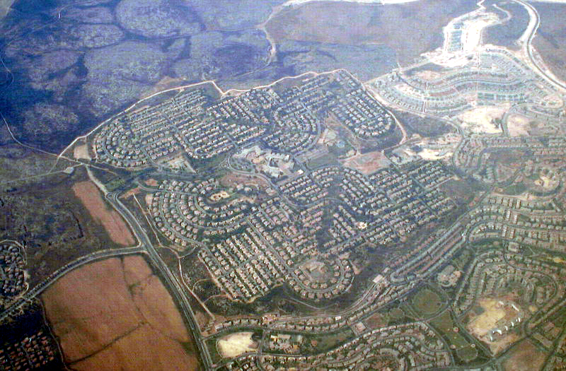
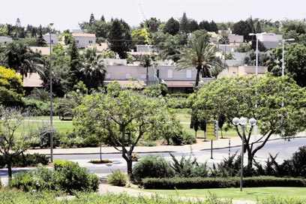
MACCABIM -REUT

Slide 9
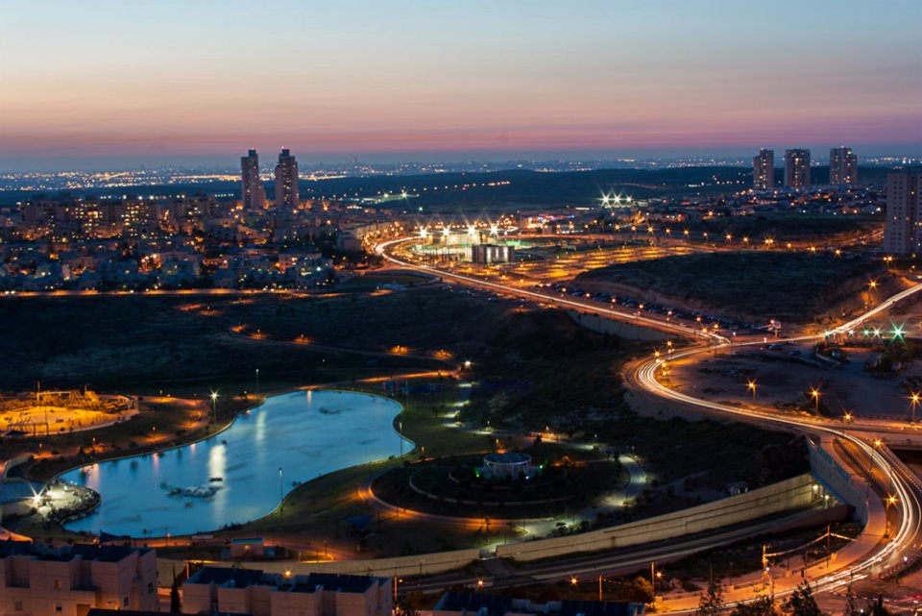
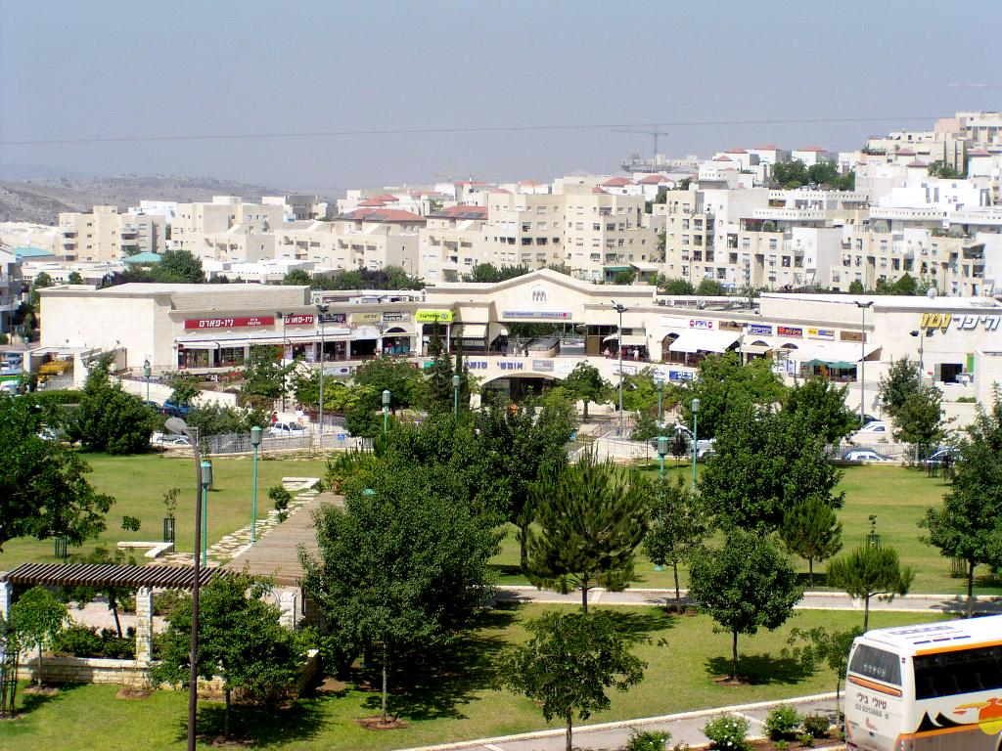
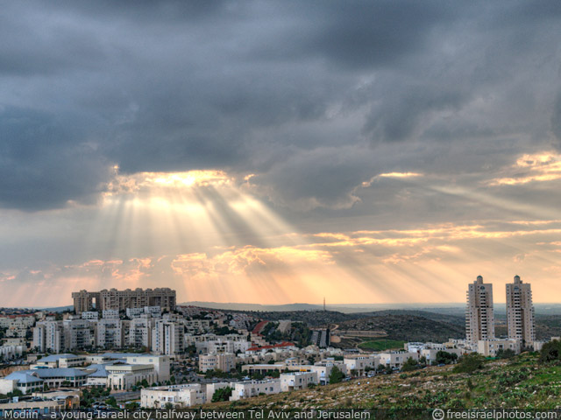
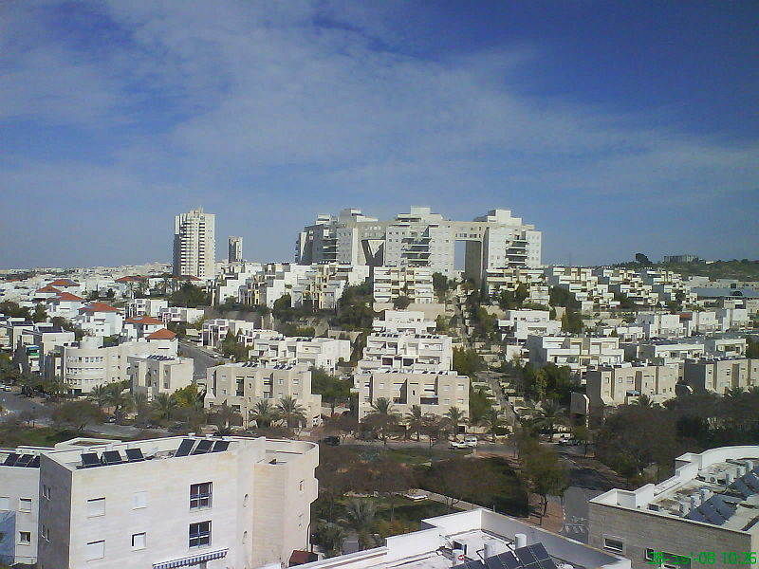
MODI’IN-
The city of the future

