Slide 1
Period 5
Key concept 5.3 – Nationalism, Evolution, and Reform

Slide 2
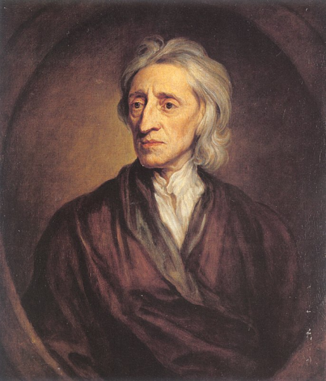
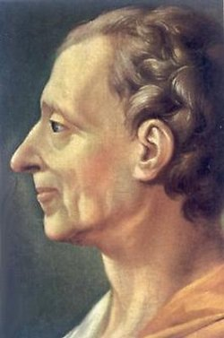
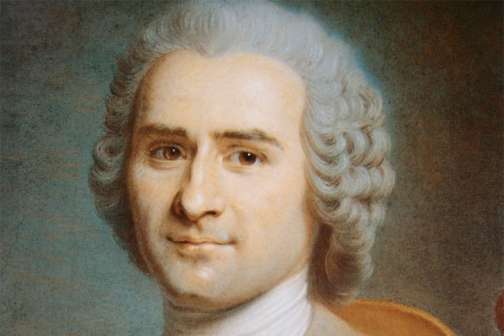
Enlightenment = rebellion & revolution
Thinkers applied new theories about the natural world to human relationships.
Thinkers encouraged observation
Names to know
John Locke
Voltaire
Rousseau
Montesquieu

Slide 3
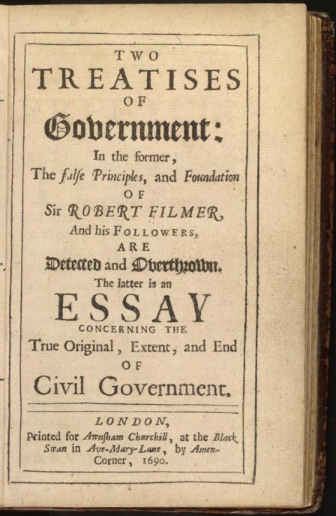
Enlightenment = Rebellion & Revolution Con.
Intellectuals critiqued the role of religion
Reason > revelation (religion)
New political ideas about the Individual, natural rights, and social contract.
“Life, Liberty, and pursuit of Property”

Slide 4
Revolutionary documents
American Declaration of Independence
French Declaration of the Rights of Man and Citizen
Bolivar’s Jamaica Letter
Ideas = challenge of social relationships = expanded suffrage, abolition of slavery and the end of serfdom.

Slide 5
The Rise of National Communities
Based on Language, religion, social customs and territory.
Governments used this idea to unite diverse populations.

Slide 6
Rebellions
Challenged the centralized imperial governments
Marathas to the Mughal Sultans
American Revolutions
French Revolution
Haitian Revolution
Latin American independence movements
Slave resistance challenged existing authorities in the Americas – Maroon societies

Slide 7
Anticolonial movements
Growing nationalism and questioning political authority = anticolonial movements
Indian Revolt of 1857
The Boxer Rebellion

Slide 8
Rebellions started for religious ideas/millenarianism
Millenarianism - belief in a coming ideal society and especially one created by revolutionary action, also end of the world.
Taiping Rebellion
The Ghost Dance
Xhosa Cattle-Killing Movement

Slide 9
Rebellion = Reforms
The Tanzimat movement
The Self-Strengthening Movement

Slide 10
“New” political ideologies
Liberalism
Socialism
Communism

Slide 11
Challenging political and gender hierarchies
Demands for women’s suffrage and an emergent feminism
Mary Wollstonecraft’s A Vindication of the Rights of Women
Olympe de Gouges’s “Declaration of the Rights of Women and the Female Citizen”
The resolutions passed at the Seneca Falls Conference in 1848

