Slide 1
Period 4
Lecture 1: Key Concept 4.1 - Communication and Exchange

Slide 2
The effects of transoceanic trade
Afro-Eurasia benefited nutritionally from American foods
European colonization, agriculture and settlements caused deforestation and soil depletion in the Americas.
More profits = more taxes = funding for visual and performing arts = (next slide!)

Slide 3
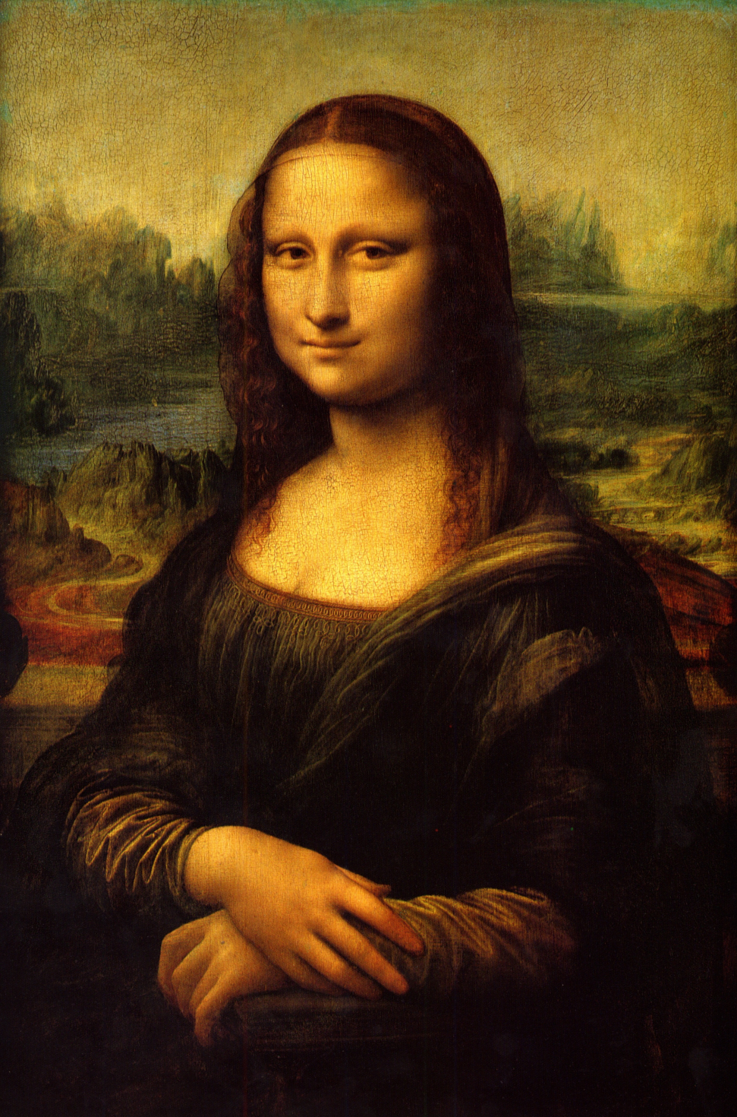
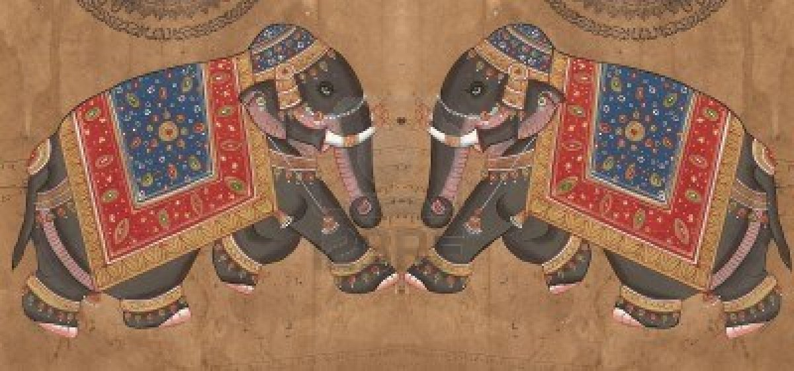
Visual and Performing arts
Renaissance art in Europe
Miniature paintings in the Middle East and South Asia

Slide 4
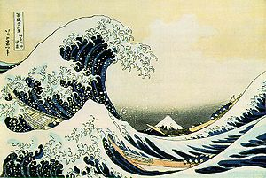
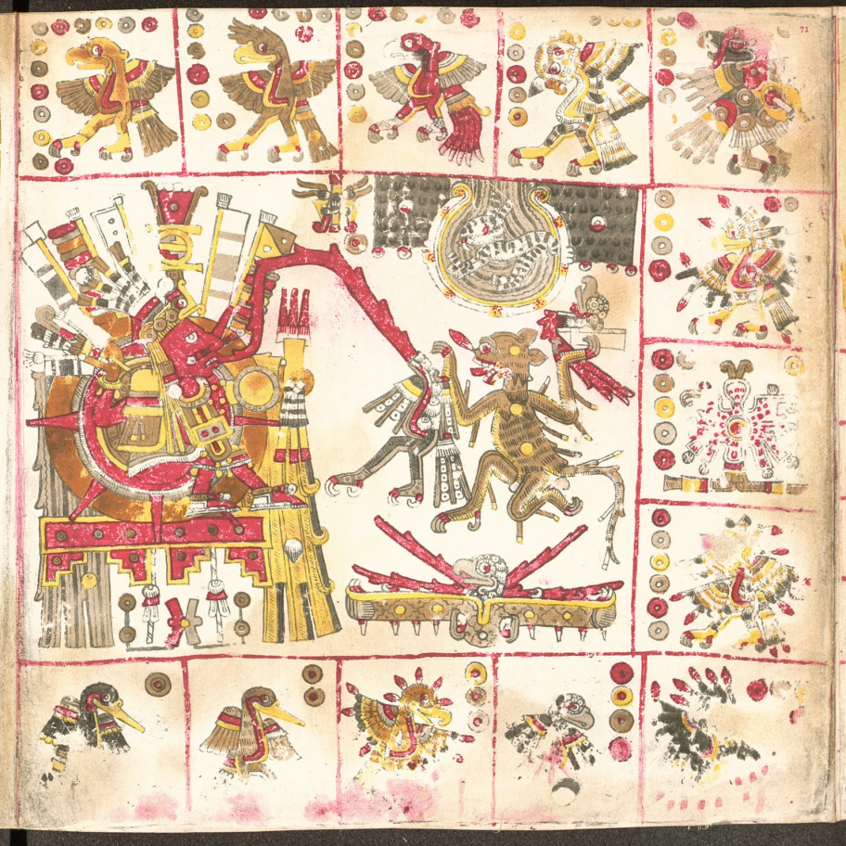
Visual and Performing arts
Wood block prints in Japan
Post-conquest codices in Mesoamerica

Slide 5
Literacy expanded
Shakespeare
Cervantes
Sundiata (Epic from West Africa)
Journey to the West (Chinese lit, Ming)
Kabuki

Slide 6
Religion
Islam spread to Afro-Eurasia and was adapted. Split between Sunni and Shi’a and Sufi became more widespread.
Christianity spread and split during the Reformation.
Buddhism spread in Asia.

Slide 7
Religion Part 2
Vodun in Caribbean (you know it as Voodoo)
Cults of saints in Latin America – Christian saints were venerated but so were colonial figures like missionaries, nuns, etc.
Sikhism in south Asia – monotheistic religion founded by Guru Nanak (Punjab region). 5th largest religion in the world. Focus on control like a saint-warrior.

