Slide 1
Imperialism
Hook: Divider activity – see map

Slide 2
Industrialization = need for more resources and markets for goods.
Europe looks to Africa and Asia.
Mid 1800’s Africa had hundreds of ethnic groups speaking 1,000’s of languages. Some large empires but many independent villages.
1880 – Europe control 10% of Africa, mainly on the coast. Difficult to explore, rivers cannot be navigated.

Slide 3
Imperialism – takeover of a country or territory by a stronger nation w/intent of dominating political, economics and social life of people.
Racism – belief one race is superior to others.

Slide 4
Europe
Maxim gun
Railroads and steamships
Cure for malaria – quinine
Racism
Missionary impulse
Africa
Variety of culture and language
Low level of technology
Ethnic strife

Slide 5
Berlin Conference 1884-5 – divides up Africa. By 1914 only Liberia and Ethiopia are free.
--1816 Zulu tribe organized under Shaka. Keeps Europeans out but falls in 1887.
--Boer War – Boers were Dutch farmers. Battle with British. First modern total war.

Slide 6
Forms of Imperialism
--colony – governed internally by foreign power
--protectorate – own internal gov’t but under control of outside power
--sphere of influence – outside power claims exclusive investment or trading privileges

Slide 7
India
Ruled by Britain
Controlled by the East India Company
Had army w/sepoys – Indian soldiers
Called the “Jewel in the Crown”
Produced raw materials
Sepoy Rebellion 1857 – over rifle cartridges
Raj – time of direct British rule 1857-1947

Slide 8
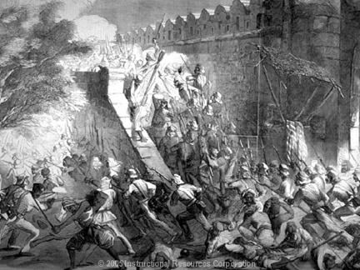

Slide 9
China
Sphere of influence
Self-sufficient, doesn’t need to trade w/west
Britain buying tea f/China. Leads to imbalance of trade. Needs a product China wants.
Opium. Leads to Opium War of 1839. China loses and Britain gets Hong Kong.

Slide 10
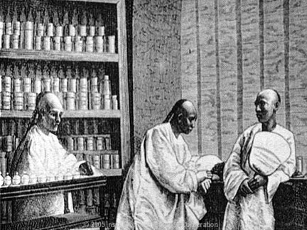

Slide 11
Others see weakness. 1899- U.S. declares Open Door Policy in China – they must trade w/all nations.
Chinese people rebel in 1900, Boxer Rebellion which is put down by foreign armies.

Slide 12
Japan
1853 Commodore Perry of U.S. enters Tokyo Harbor w/4 warships. Has note from President Fillmore. Forces Japan to trade w/ U.S.

Slide 13
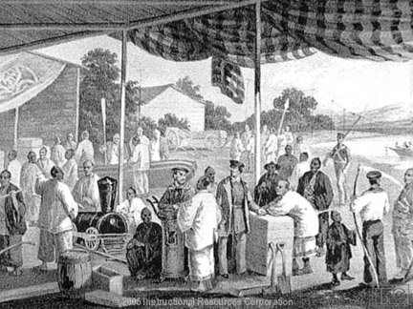

Slide 14
Reading work
Read pg 352 – 365 taking Cornell or 4 square notes.

