Slide 1
History Alive – French Revolution
Pictures and Questions

Slide 2
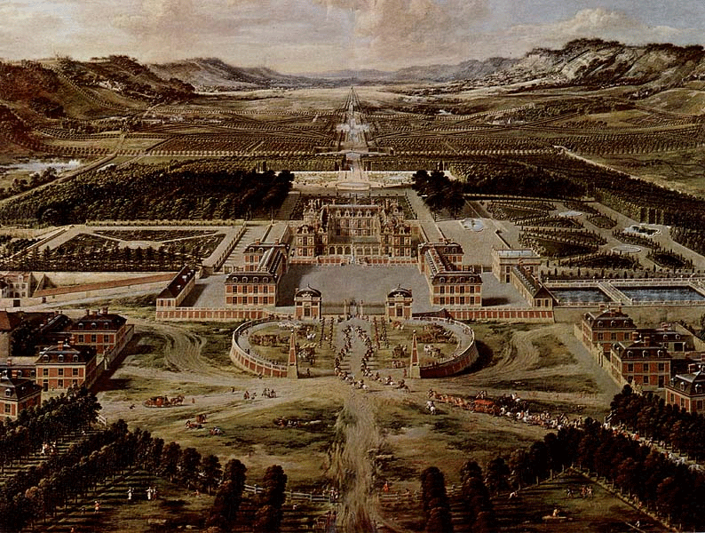
How did Louis XIV use the palace to increase his power? How does this relate to the themes of this unit?

Slide 3
End of Round 1 Questions
How does it feel to be “born” into a role you cannot change?
What are some of the advantages of organizing a society in this way? What are some disadvantages?
What do you think should be done to save the French nation?

Slide 4
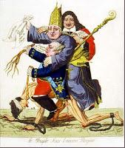
What does this
Pictures tell us
About French
Society?
Does this
Remind us of any
Other societies
We’ve studied?

Slide 5
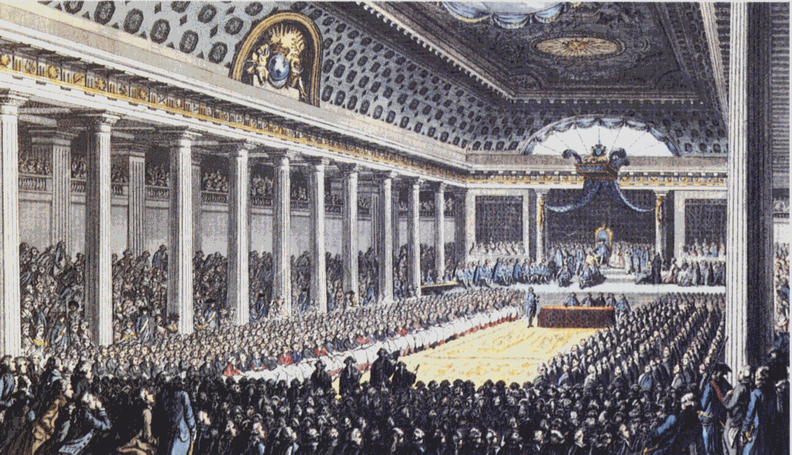
The Estates General: Good idea? Bad idea?

Slide 6
The End of Round 2
Was the King’s choice of how he dealt with the Estates General a good choice? What should he have done? Why?
Does this remind you of any other time in history?

Slide 7
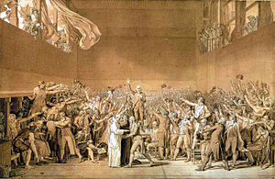
The Tennis Court Oath

Slide 8
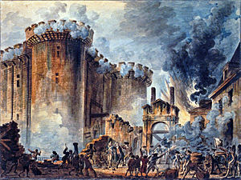
Storming of the Bastille

Slide 9
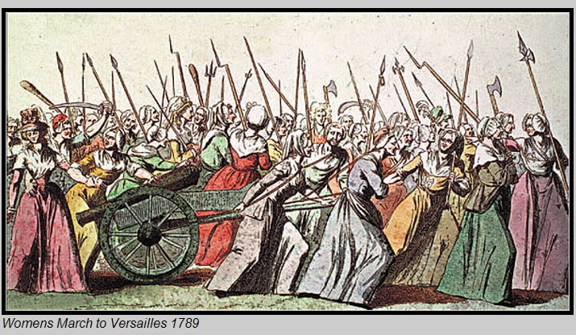
The March on Versailles

Slide 10
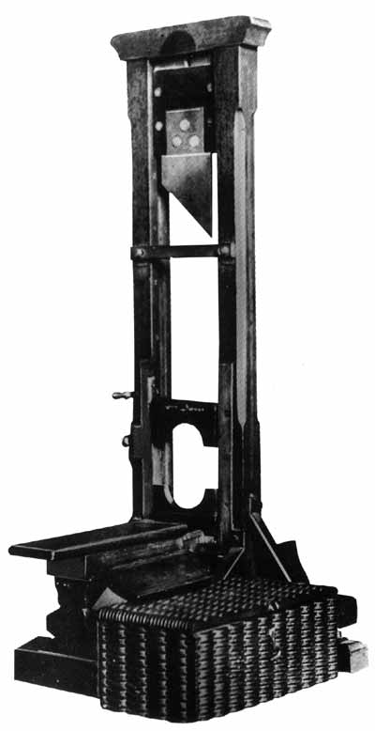

Slide 11
The End of Round 3
Was it inevitable that Napoleon come to power? Why or why not?
Did Robespierre have to die?

Slide 12
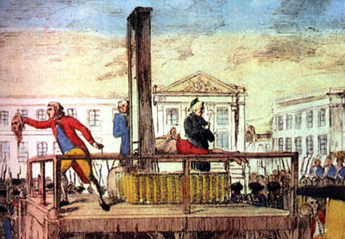
The Execution of Louis XVI

Slide 13
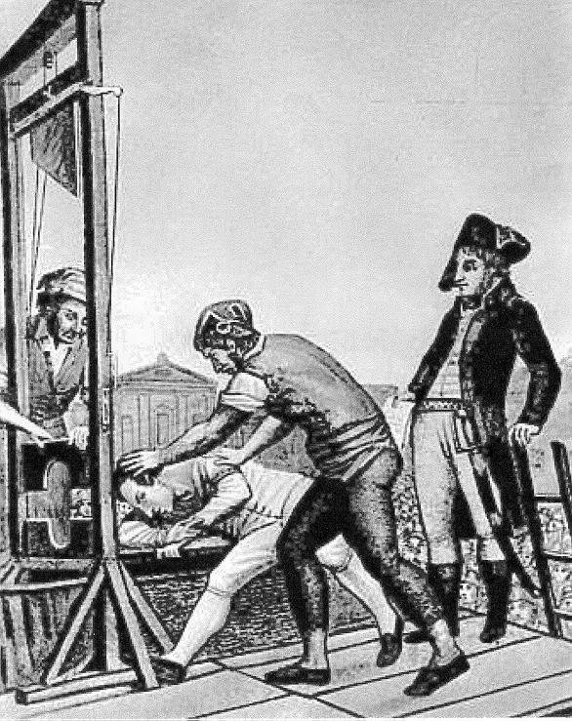
The Death of Robespierre

Slide 14
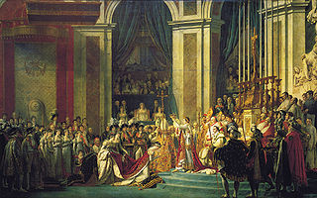
The Coronation of Napoleon

