Slide 1
England in the Age of Absolutism
Journal at the end of the Quick Notes today!
http://www.youtube.com/watch?v=uw9Zu9w_N_E

Slide 2
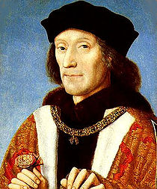
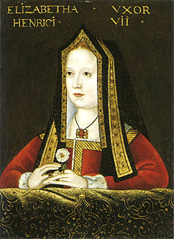
The House of Tudor
Tudors came to rule England in the late 1400s
Henry VII was the first Tudor king
Made England stable and prosperous

Slide 3
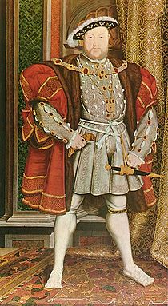
Henry VIII
Changed the religion of the people of England (changed the Church of England from Catholic to Anglican, which is a form of Protestantism)

Slide 4
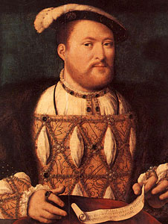
Henry VIII
Henry married Catherine of Aragon (his former brother’s wife) in 1509, but wanted to divorce her because she would not bear him a son
Went to the Pope to get divorced (you can’t get divorced in the Catholic church), and the Pope would not grant him one
So, to divorce his wife, he changed the whole church of England

Slide 5
Henry VIII
Henry went on to have 5 more wives after Catherine (6 total)
Anne Boleyn (m. 1533 – 1536)
Jane Seymour (m. 1536 – 1537)
Anne of Cleves (m. Jan. – July 1540)
Kathryn Howard (m. 1540 – 1542)
Katherine Parr (m. 1543 – 1547)
http://www.youtube.com/watch?v=-fadCAHjN-s

Slide 6
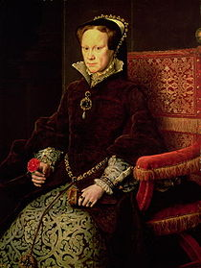
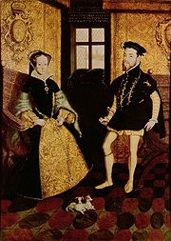
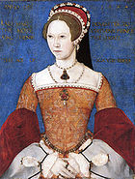
Mary I
Because of the executions of protestants, she became known as Bloody Mary
Failed to destroy Protestantism

Slide 7
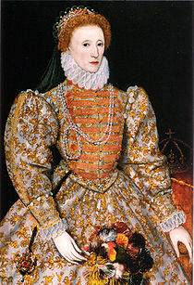
Elizabeth I
Ruled from 1558 to 1603
5th and last monarch of the Tudor dynasty
Also called the Virgin Queen or Good Queen Bess
Daughter of Anne Boleyn and Henry VIII
Protestant (briefly imprisoned by her sister Mary for her beliefs)

Slide 8
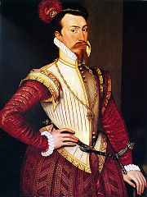
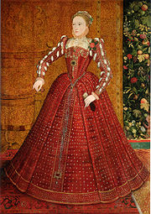
Elizabeth I
Never married
Knew she was infertile
Very involved in affairs of state
Very in touch with the English people
“Virginia” is named for her

Slide 9
Elizabeth I
Reign called the “Elizabethan Era” or the Golden Age
England advanced in many areas during her reign

Slide 10
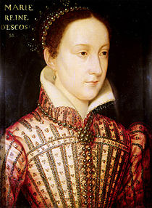
Mary Queen of Scots
Mary Stuart, Queen of Scotland
Inherited the throne of Scotland when she was 6 days old
Was pledged to marry at age 5 to a 3 year old French prince to ensure Scottish-French relations
Lived in France for most of her childhood
Closest relative to Elizabeth I

Slide 11
Mary Queen of Scots
Mary was Catholic and this worried English Protestants (didn’t want another “Bloody Mary”)
Was put in prison by Elizabeth I when she fled to England to escape Scotland in 1568
Later, Mary plotted to kill Elizabeth I with Philip II’s ambassadors (remember, Philip of Spain was married to Mary I)
Elizabeth found out Mary’s plan and had her beheaded in 1587

Slide 12
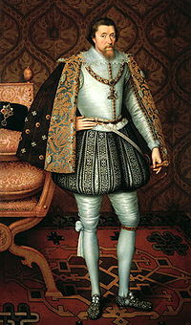
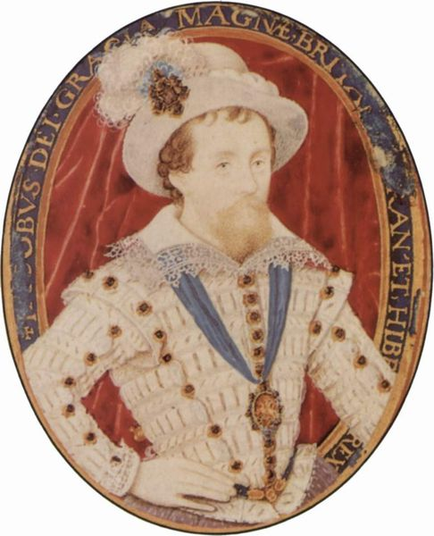
James I
Because Elizabeth died in 1603, Mary Queen of Scots’ son, James, became king
Was from the Stuart family, not the Tudors, thus starting a new dynasty
Believed in the Divine Right of Kings (so he didn’t work well with Parliament)
Protestant
King when Capt. Smith and Newport left for the New World (James River and Jamestown is named for him)
Golden Age of England continues under him

Slide 13
Journal
What did the English Kings and Queens do that was different from Russia and France in the age of Absolutism?

