Slide 1
Russia in the Age of Absolutism
Journal: If you had absolute control over the school what changes would you implement?

Slide 2
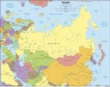
Russia
Russia is geographically and culturally isolated from the rest of Europe

Slide 3
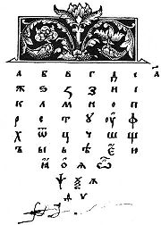
Russia
Cultural isolated from Western Europe:
Religion: Eastern Orthodox
influenced by Byzantine Empire
Alphabet: Cyrillic
Previously ruled by the Mongols

Slide 4
Russia
Grand Duke Ivan IV (Ivan the Terrible) was officially crowned the first tsar or czar ("Caesar“ or king) of Russia in 1547
After Ivan died in 1584, Russia went through a period of unrest because there was no king
Romanovs were named the royal family of Russia (and would remain in power until the 1917 Russian Revolution)

Slide 5
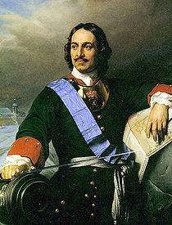
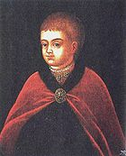
Peter the Great

Slide 6
Russia
Pre-Peter the Great life in Russia (Don’t write this down!)
Non-modern country
Women were secluded and wore veils
murder, kidnapping and torture were a regular part of life
No middle class
If you killed a serf on a farm, you simply had to replace him
Intellectual activity was nearly non-existent
there was no literature to speak of, and no newspapers
Russians did not understand arithmetic or science, and had a calendar that dated from “Year 1, the beginning of the world”

Slide 7
Peter The Great
Ruled until 1725
Major goals:
Creating a strong military
taking the Black Sea from the Ottomans
Westernizing/Modernizing Russia
More education
Bigger economy
More culture
Making a new capitol city
He was successful at them all

Slide 8
Peter the Great
Looked at the court life at Versailles
How the Prussians used their military.
Studied under shipbuilders in Holland
Met with leading scientists and artists

Slide 9
Peter the Great
Abandoned the capitol city of Moscow and built St. Petersburg
Copied the palace of Versailles and other French government buildings

Slide 10
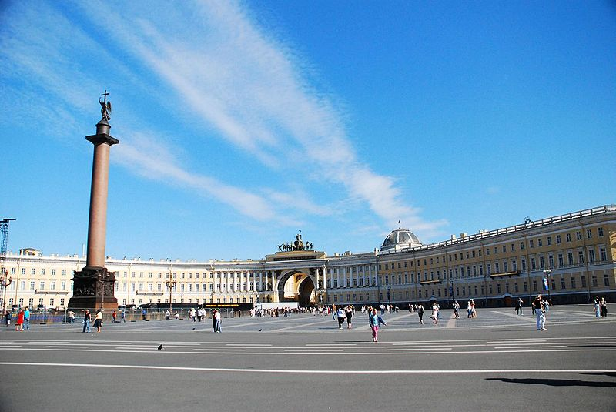

Slide 11
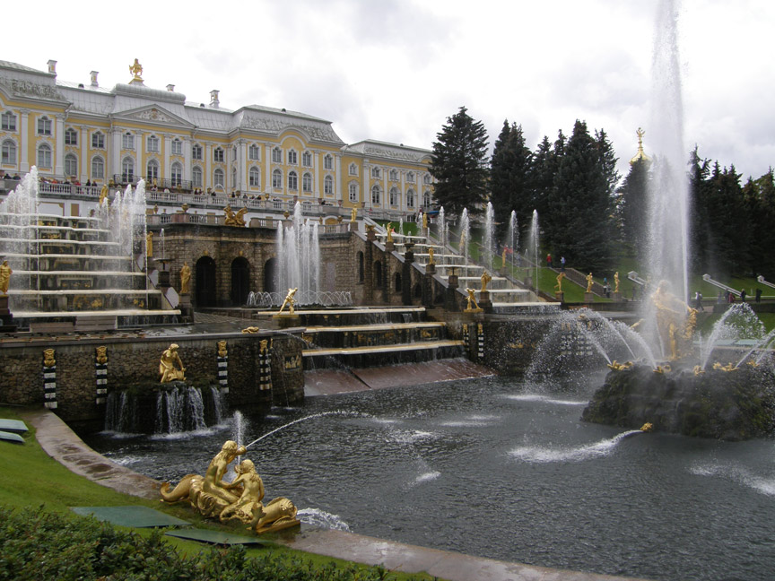

Slide 12
Peter The Great
Most absolutist of the absolute monarchs
He modernized all of Russia except for the poor
The poor have many new taxes
They remained uneducated and illiterate
His successors did not continue his harsh policies

Slide 13
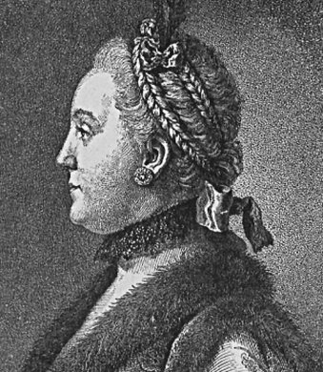
Catherine the Great
Peter the Great’s Granddaughter-in-law (Married Peter III)
She became Catherine II, or Catherine the Great
Ruled from 1762 - 1796

Slide 14
Catherine the Great
Continued Peter I’s legacy of expanding Russia (gained land near the Black Sea, in Poland, and east of the Urals in present day Siberia)
Well-educated (read authors such as Voltaire and Montesquieu)
Stressed importance of education in Russia
Promoted local government; broke Russia into districts
Improved medical care (she took the first vaccine in Russia to show others they should do it)

Slide 15
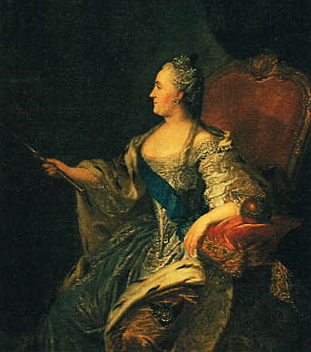
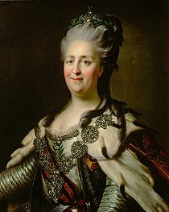
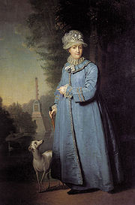

Slide 16
