Slide 1
France in the Age of Absolutism
Journal: Which country of the five emerging powers will have the strongest ruler and why?

Slide 2
Louis XIV
After the Thirty Years War, France became the great model of absolutism in Europe
Ruled for 72 years (longest reign in French history)
Called the “Sun King”
Proclaimed “L’etat c’est moi” (“I am the state”)
Made France a military, economic and cultural powerhouse

Slide 3
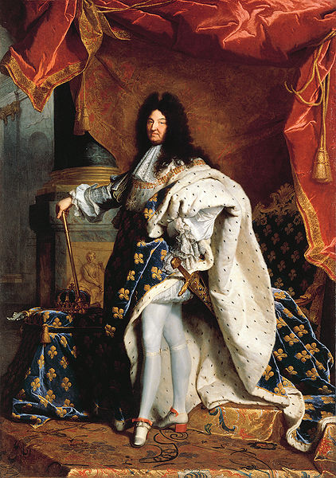
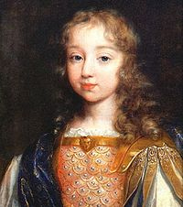
Above: Louis as a child
Right: Louis as king of France

Slide 4
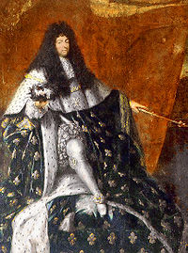
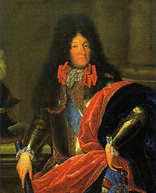
Louis XIV
achieved the greatest monarchical power of the modern age as demonstrated by
1) the palace at Versailles (video break!)
2) luxury of the French court
3) the brilliance of French culture during his reign.
Renovation of the Louvre (now one of the world’s greatest art museums

Slide 5
Louis XIV
Louis’ absolute power stemmed from four reasons:
1) Church: he controlled religion
2) Nobility: he no longer even consulted with the aristocracy for advice
he kept them happy with rituals, processions, banquets, duties at court, etc.

Slide 6
Louis XIV
3) Commoners: many commoners were made loyal to Louis by being given titles of nobility
4) Revenues: tax collection was not in the control of the nobles but the king’s own men called intendants who controlled the 322 districts France was divided into during Louis’ reign

Slide 7
War of Spanish Succession
France vs. England & Netherlands in alliance with H.R.E. & Austrians) to see whose child would rule Spain.
It ended with the Treaty of Utrecht (Holland)

Slide 8
Treaty of Utrect
No country really got stronger than before, except England.
It “created a balance of power in Europe with Britain emerging as a major force in European affairs, the counterweight against the French colossus.”

Slide 9
Louis XIV’s Legacy
left France impoverished and surrounded by enemies.
Bad harvests, the plague in the 1690s and Louis’ wars and taxes (taxed the peasants to death!) led to widespread poverty, misery and starvation
failure to relieve the suffering of the lower classes would lead to the French Revolution of 1789.

