Slide 1
From Absolutism to Revolution
Journal: Name at least 5 qualities that are important for a monarch to possess and tell why.

Slide 2
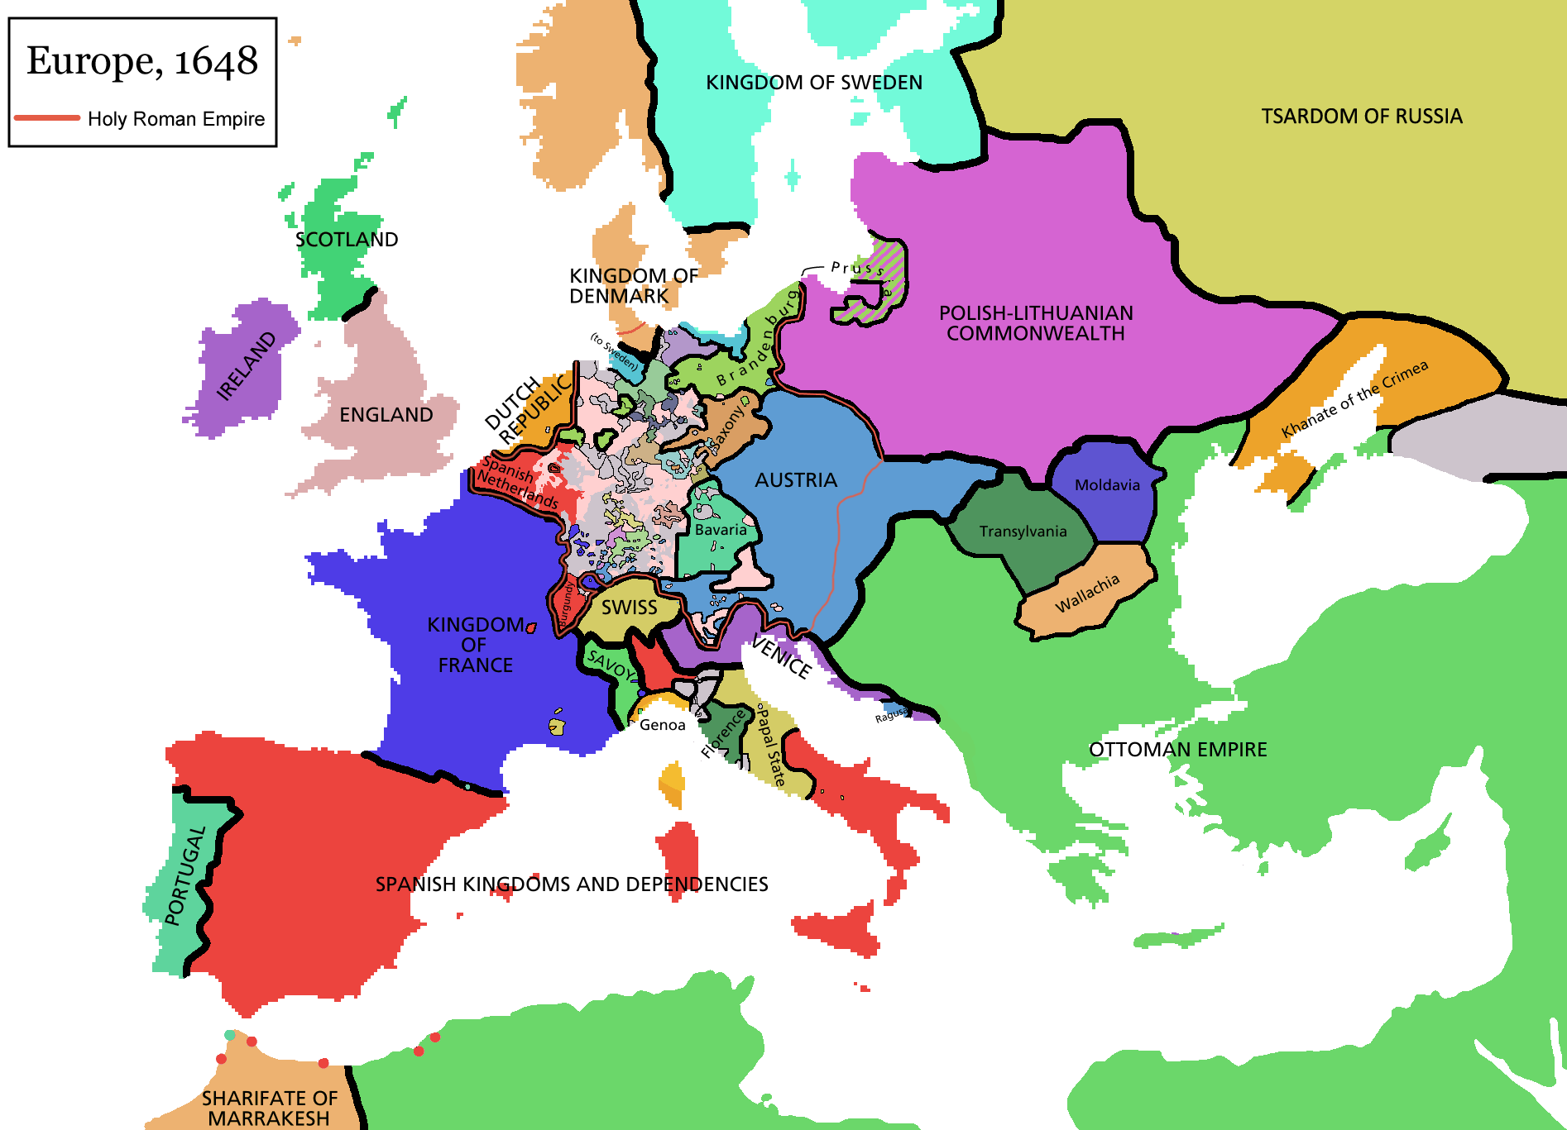
Europe after the Treaty of Westphalia (ended the 30 yr war)

Slide 3
Age of Absolutism
Towards the end of the Middle Ages, feudalism broke down.
Strong central governments led by kings appeared in parts of Europe.
These kings believed in the Divine Right of Kings, meaning they believed that they represented God on earth and everyone should obey them (known as absolute monarchs)

Slide 4
Age of Absolutism
Kings were also able to rise quickly because of the Reformation
Many nations had erupted into civil wars over religion (Protestants v. Catholics) and many innocent people were dying
The Thirty Years War is a great example of this
A strong king provided leadership, safety, and peace
In order to achieve this stability, absolutists controlled the military, tax collection, and the judicial system

Slide 5
5 Emerging powers!
England
France
Austria
Prussia (will become Germany)
Russia

Slide 6
Homework~
To be started in class:
Reading pg 155 – 161 – notes required
and question number 2 and 8 on page 161

